Slide 1
Midterm Progress Report
Survey Program for STEM Academyehmar
By
Ehmar Khan
Jiaxu Li
Munisha Parikh

Slide 2
Who are we?
Front-End Development:
•Jiaxu Li
•Munisha Parikh
Back-End Development:
•Ehmar Khan
Our Client:
•STEM Academy

Slide 3
Brief Introduction
STEM Academy engages K-12 youth in programs designed to increase college attendance and participation in the STEM fields.This presentation contains our journey from the start of Winter 2018 up till now . We will be briefly talking about the purpose and goals of the project. We will also be talking about where we are on the project currently and what were the problems we faced in this term so far, and also how we overcame the problems we faced during this term.

Slide 4
Purpose
Make a well-functionally survey system for STEM Academy
Make an Extra tab for the website
Tutorial for our clients

Slide 5
Goals
A system that allows them to add surveys without going through adding and replacing CSV files.
Allows students to change their answers
Allow Clients to make changes in the survey if the students adds wrong information
Allow the database to create graphs and reports.
Allow the clients to merge similar questions from different surveys
Also allow the clients to make import and export survey data
To make an extra tab on the STEM ACADEMY website to add about impacts about their programs

Slide 6
Sample Survey
The clients asked us to survey a sample data which they provided us with. The sample data were questions and responses from the precamp and postcamp surveys of a previous camp. They wanted us to test out some functions like merging the data, comparing changes in responses to similar questions from pre camp and post camp surveys after the camp, and generating different types of graphs and reports. We created the survey in Qualtrics using the provided data and tested out the functions and report generation mechanisms, and demonstrated them to our clients. They want to know if it can be possible to merge and compare reports of several surveys from past years, which we are currently working on.

Slide 7
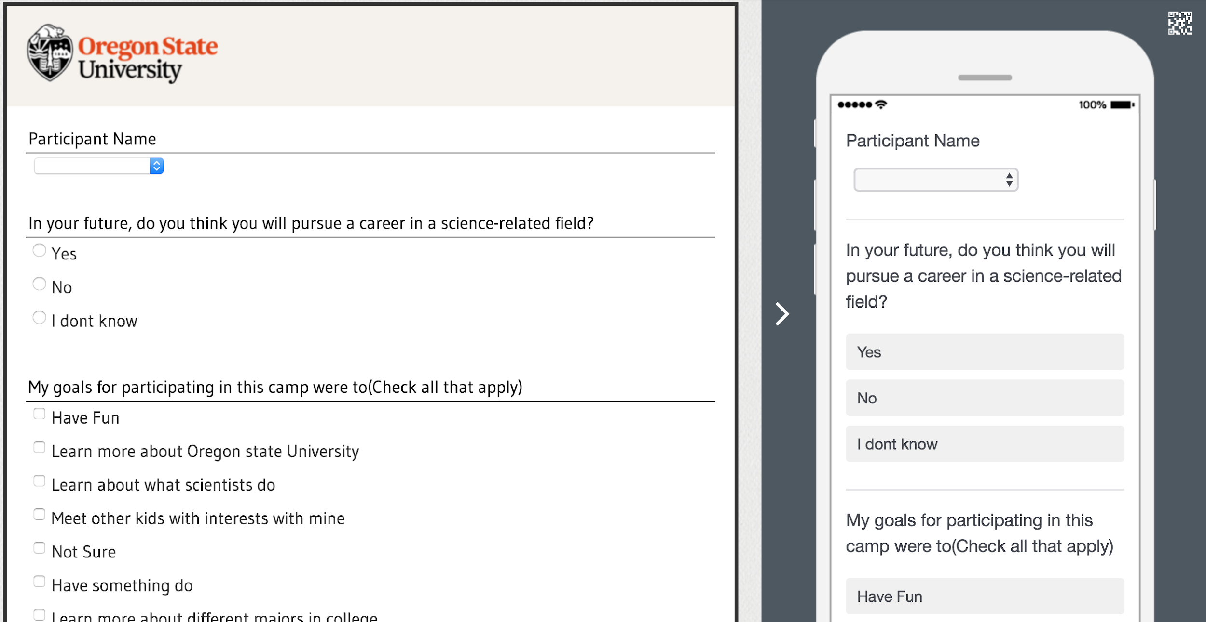

Slide 8
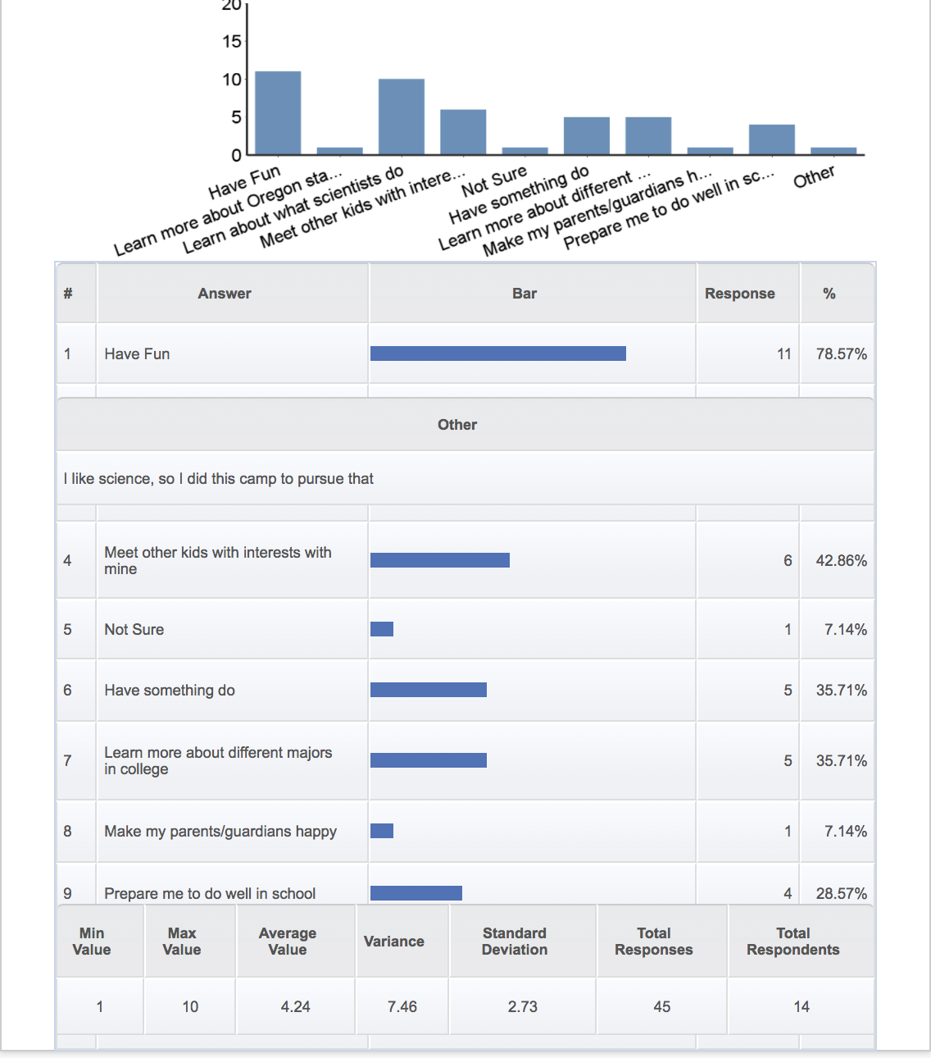
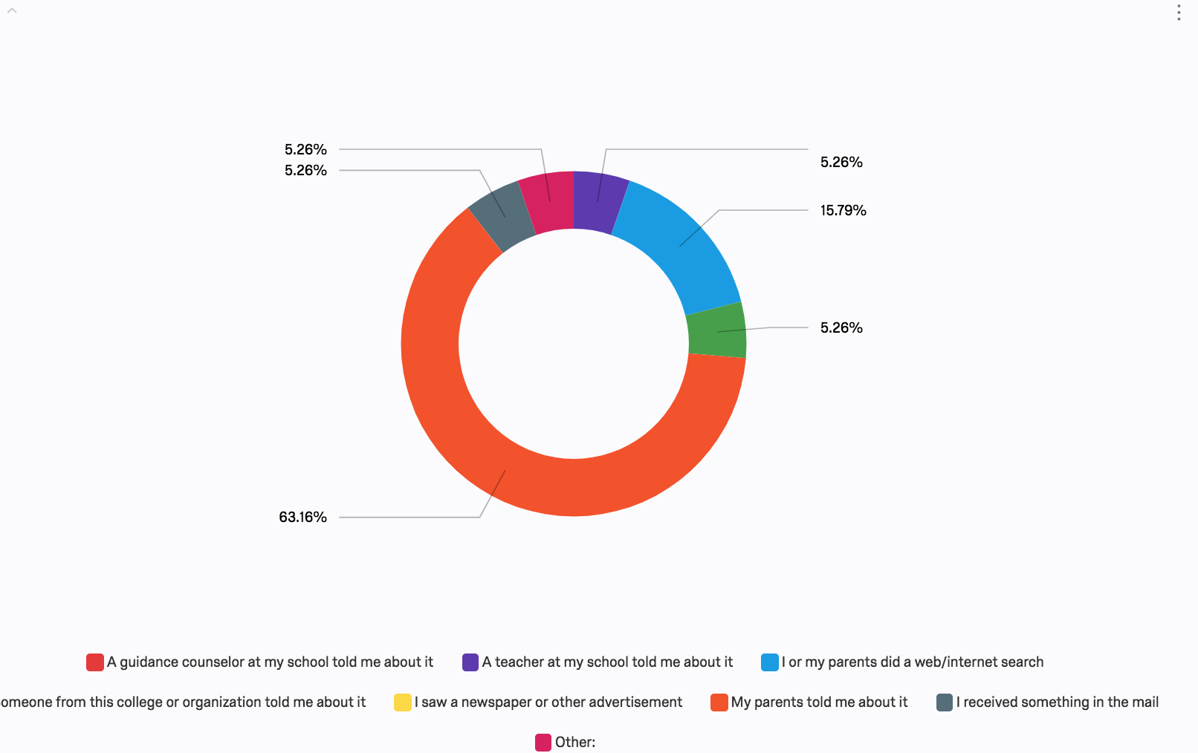

Slide 9
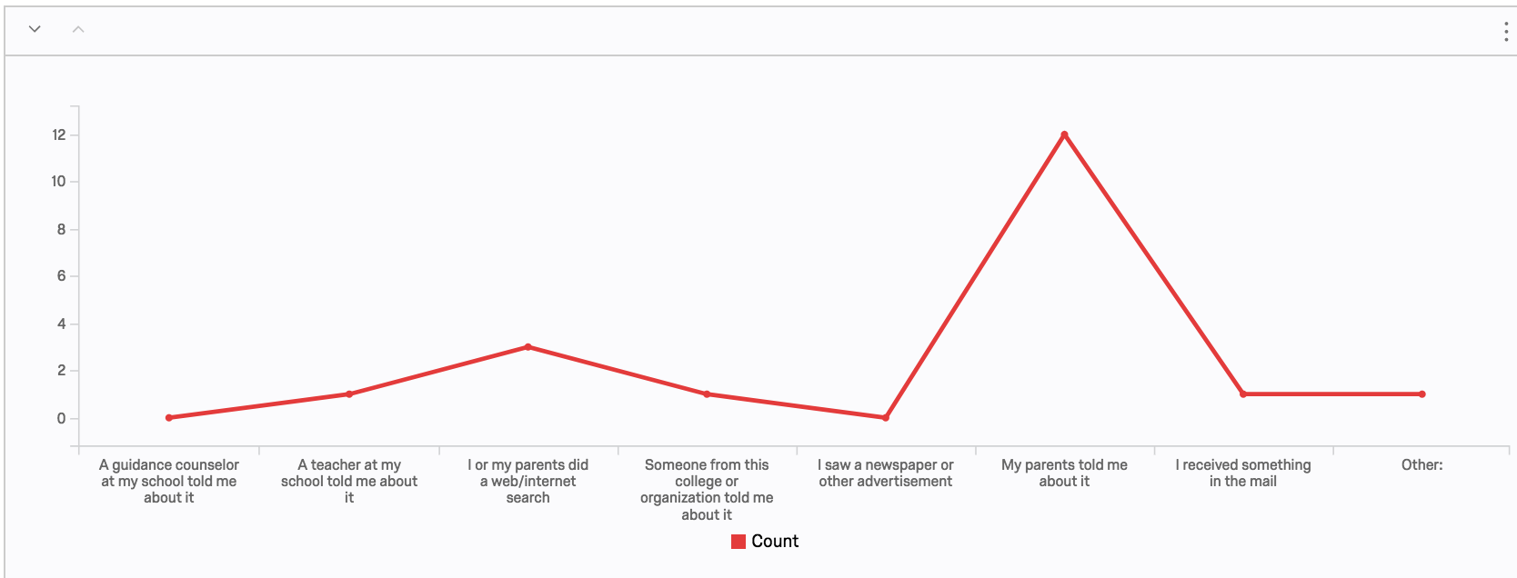
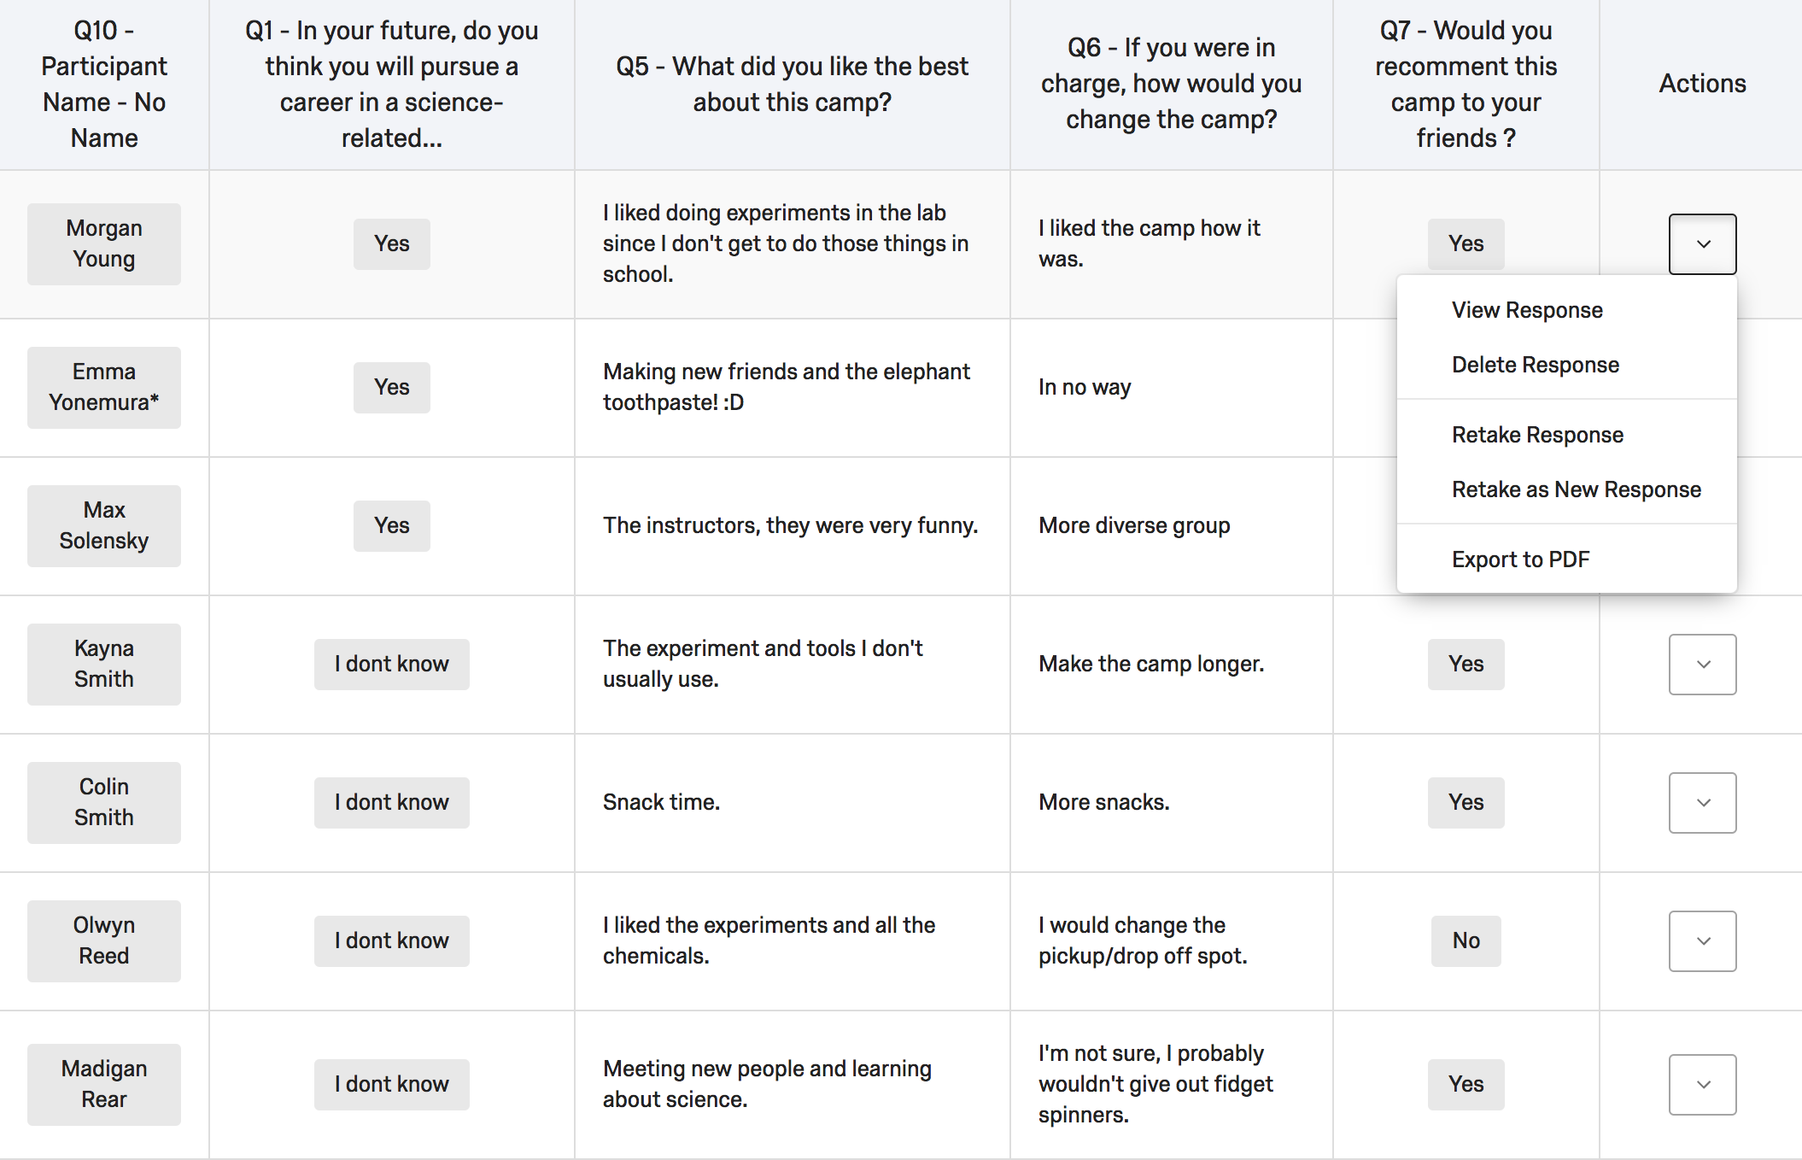

Slide 10
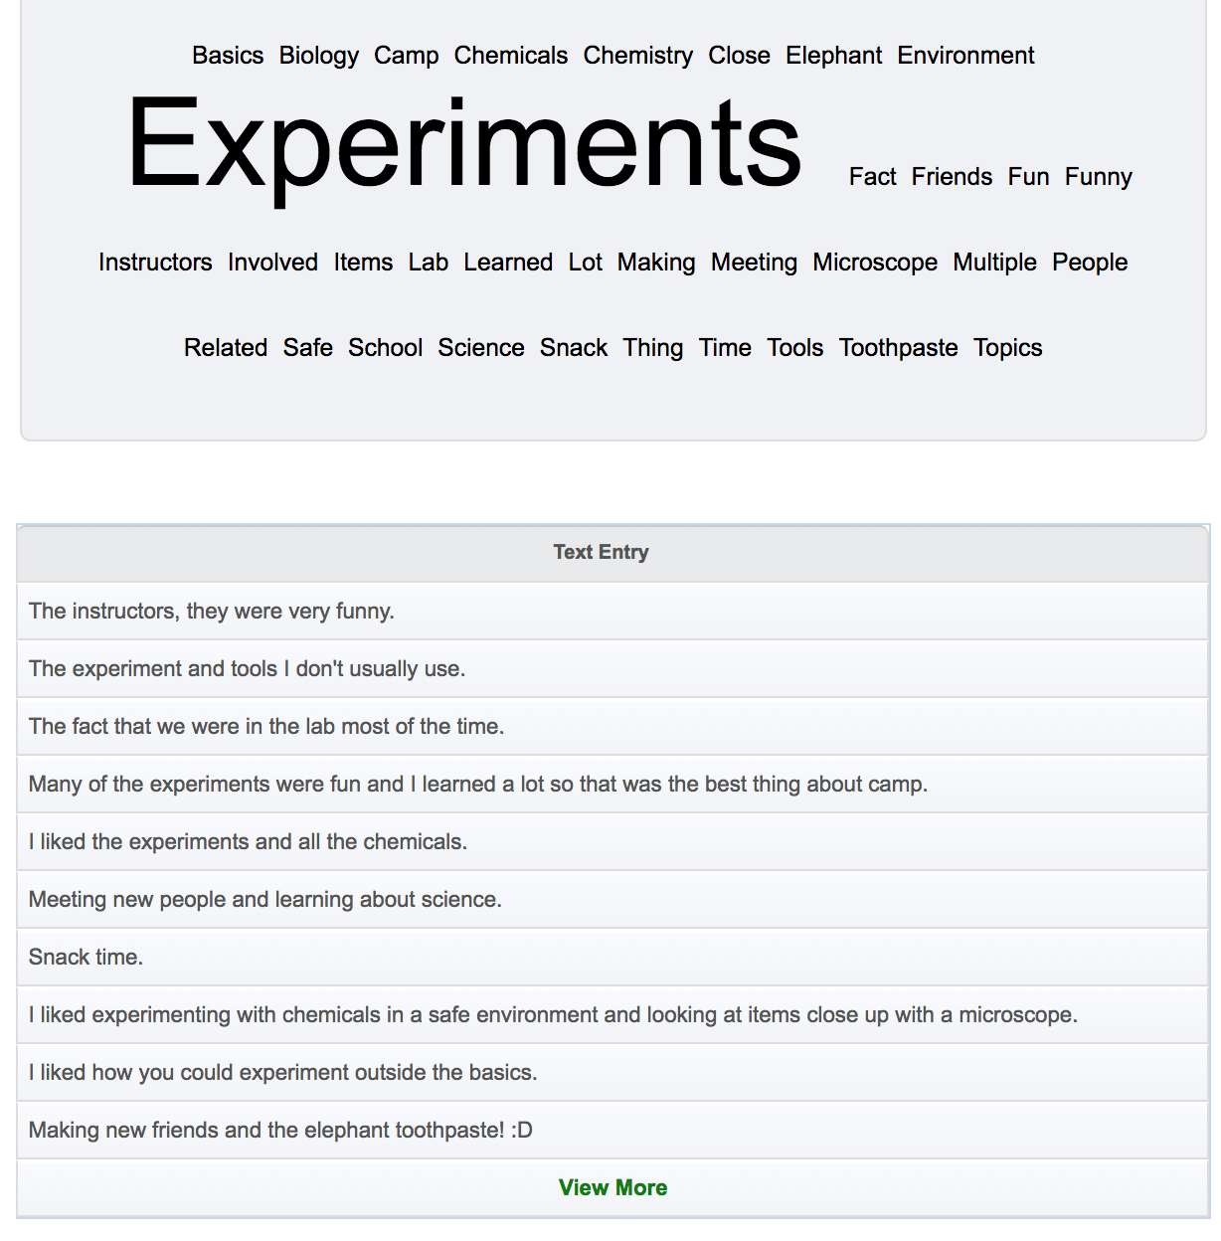

Slide 11
Where We are Currently On the Project
The main work was changed because we found a better solution (approved by our client).
Qualtrics could be our best choice.
Started to research on Qualtrics.
Creating a blank survey
Distribute survey via email, website, QR code, etc.
Test the data section based on the requirements of our client.
Generate a standard report including graphs
Made a tutorial which is designed for our client.

Slide 12
What We Have Left To Do
Tutorial
Test how to merge Qualtrics reports
Compare the data of different years
Create a different tab for the STEM Academy

Slide 13
Problems We Met, And Solutions
Merging different reports
Access to code

